Slide 1


Amazon Sales Data Study (2020-2021)

Slide 2
Approach
Assigned lead person for each section of the project as follows:
Christine Chung (Documentation Lead)
Andy Bhanderi (Presentation Lead)
Dzemal Crnkic (Software Version Control Lead)
Shephali Dubey (Visualization Lead)
Girish Hossalli (Data Analysis Lead)
J'mari Hawkins (Data Acquisition Lead)
Every person was involved in every aspect of the project rather than 1 person doing 1 part of the project and the lead person was responsible for leading , recommending , and assisting the team members for their assigned section.

Slide 3









Table of Content
Objectives
Data Sources
Demographics
Order Trends
Sales Trends
Discount
Consumer Sentiment
Conclusions
Lessons Learned

Slide 4
Objectives
Primary Objective
Motivations
Overall Goal
Analyze Amazon sales data from October 2020 to September 2021.
Identify growth opportunities
Analyze sales trends
Optimize sales processes and forecasting
Explore market dynamics
Customer behavior
Evaluate customer satisfaction and retention
Promote data-driven decision-making

Slide 5
Data Sources, Cleaning & Analysis
Sources:
Analysis of Data:
Kaggle
286,000 data points
University of Michigan
15 Product Categories
Bureau of Labor Statistic
Time range Oct 2020 - Sep 2021
Sales regions
Customer demographics
Discount Information

Slide 6
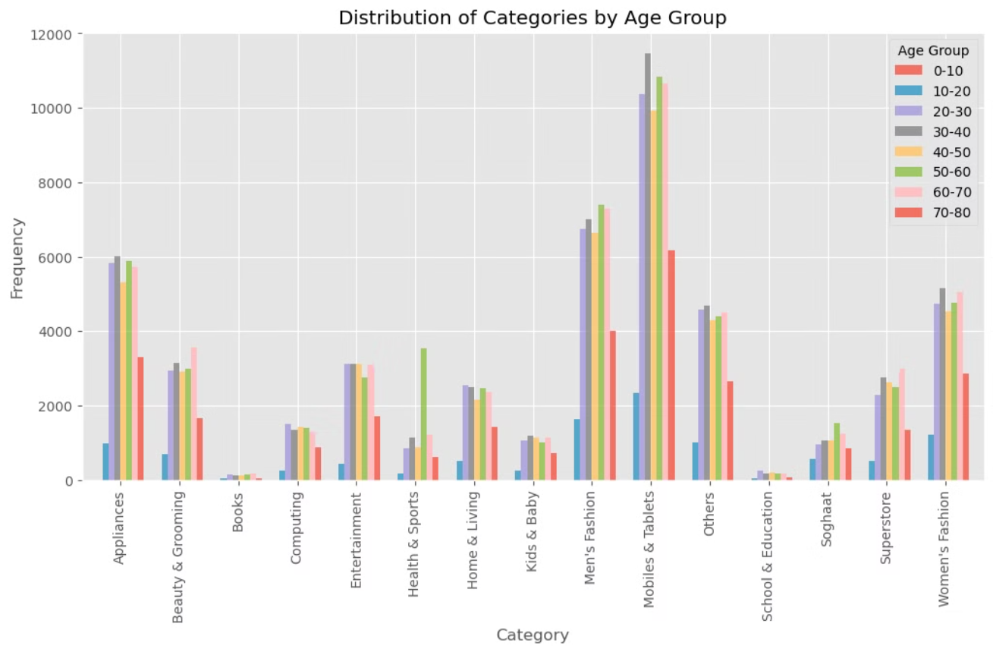
Age Trends

Slide 7
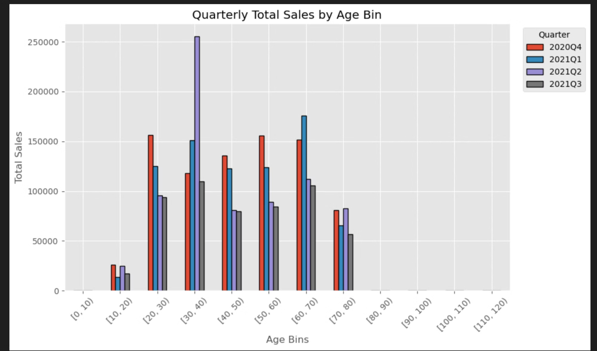
Age Trends cont.

Slide 8
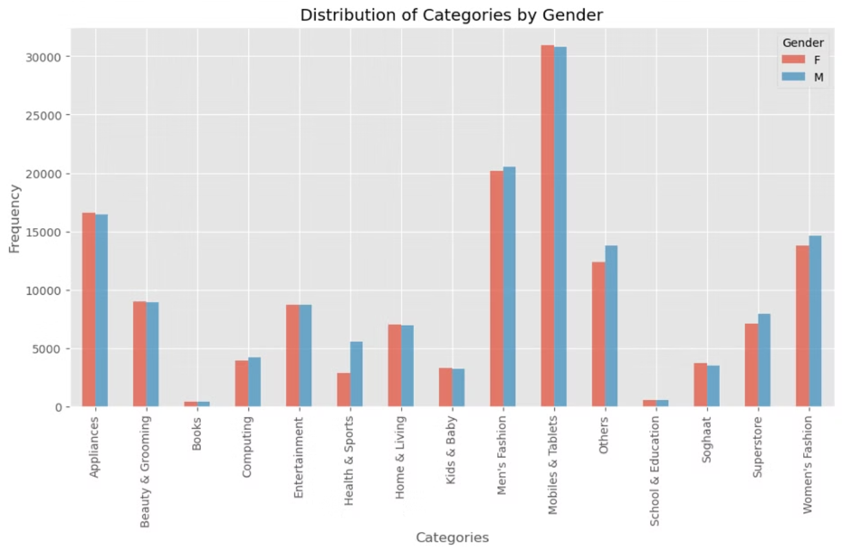
Gender Trends

Slide 9
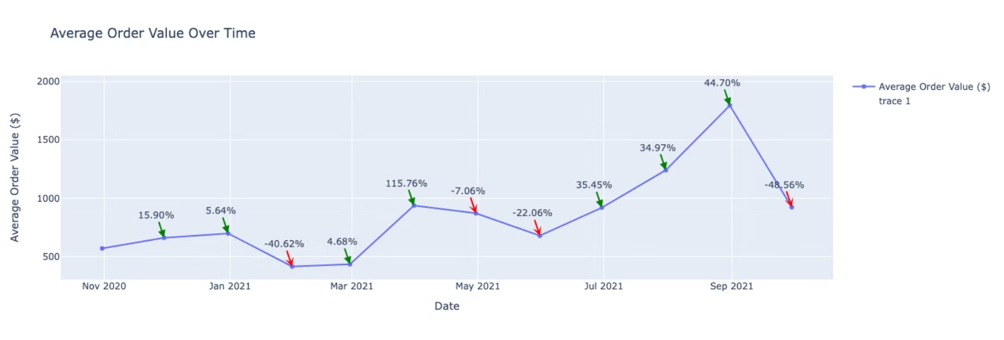
Average Order Values Over Time

Slide 10
Average Order Values Over Time
The average order value over several months along with the percentage change from the previous month.
A strong suggestion to address these fluctuations is to implement a targeted marketing strategy based on seasonal trends and consumer behavior analysis. Here are three strategies to support this suggestion:
Segmented Promotions
Seasonal Product Bundles
Personalized Recommendations
By implementing these strategies, businesses can better adapt to seasonal fluctuations and optimize average order value, ultimately driving revenue growth and enhancing customer satisfaction.

Slide 11
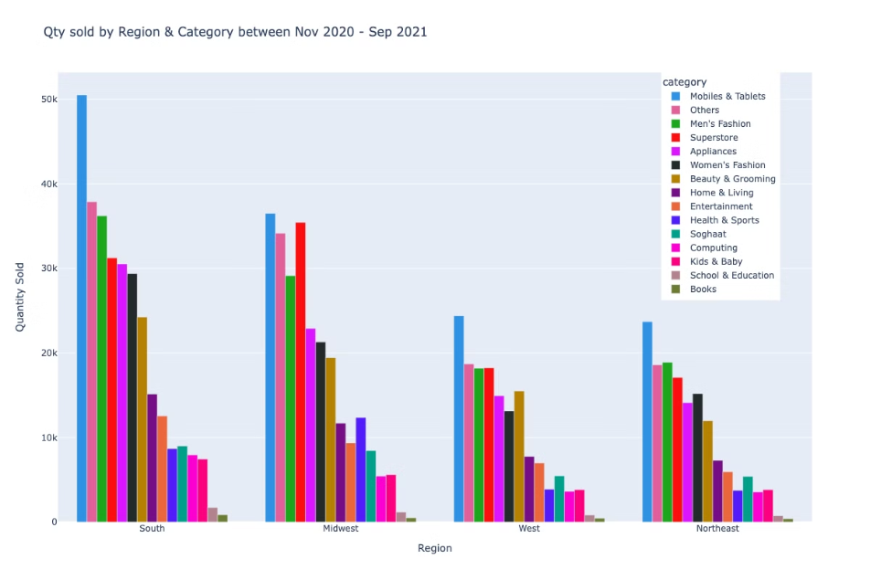




Sales Trends by Region and Category
Highest Sold Category
Least Sold Category
Highest online Region
Highest instore Region
Mobile and Tablets
Books
South
Midwest

Slide 12
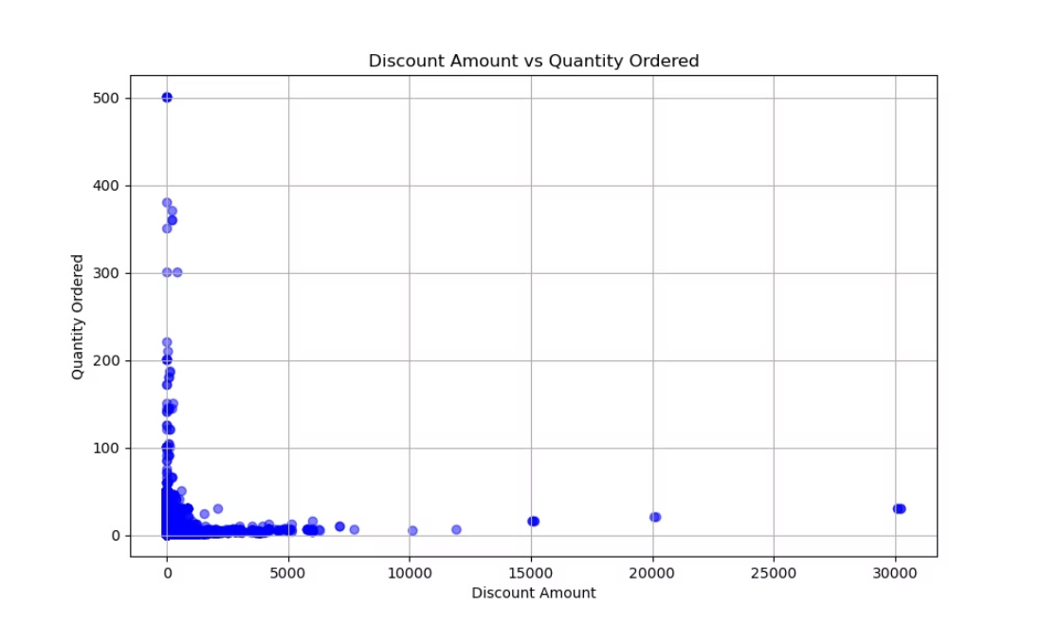
Discount Analysis
There is no clear linear relationship between quantity ordered and discount amount (correlation = 0.02)

Slide 13
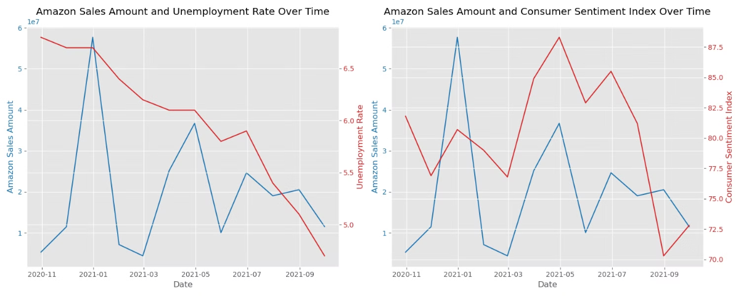
Unemployment & Consumer Sentiment
Sales Vs Unemployment Rate
There appears to be an Inverse relationship where the sales amount increases sharply as the unemployment rate remains relatively high initially.
As the unemployment rate decreases, the sales amount shows more variability and ultimately decreases.
Sales Vs Consumer Sentiment Index
Amazon sales and the Consumer Sentiment Index do not appear to be correlated
When the Consumer Sentiment Index is high, it suggests that consumers feel confident about the economy, which may lead to increased spending and thus higher Amazon sales. There are periods where the trends do not align.

Slide 14
Conclusions
Categories
Demographics
Discount Analysis
Inventory Stocking Recommendations
Show interesting trends across product segments.
Reveal age-based buying patterns.
No clear correlation between discounts and sales volume.
Highest sales from Mobiles & Tablets
Electronics and Home Goods: Consistent growth
Younger customers: Favor Tech and Fashion
Discounts used more for lower-priced items
South region as the highest sales region
Older shoppers: Gravitate towards Home and Health products
Books: Declining
No clear pattern between discount and sales.
Recommend higher volume of Mobiles & Tablets stock in local DC
Highlights:
Data highlights:
The product mix, sales, and pricing strategies.
Focus on specific customer segments and category trends.

Slide 15
Lessons Learned
Data Challenges
Tech challenges and Future ideas
Limited access to Amazon sales data
Utilizing Git LFS for handling large data file uploads
Utilized a clean sample dataset on Kaggle
Addressing merge conflicts effectively
Considerations for reliability of trends during the COVID-19 crisis
Harnessing gamma.app for enhanced functionality
Utilizing Jupyter Notebook Classic & Rise for interactive features
Recognizing the potential benefits of a bigger dataset (multiple fiscal years) for deriving better conclusions and identifying possible correlations.
Implementing a modular development methodology
Exploring diverse areas of interest during data gathering phase

Slide 16
- Q&A
Thank you

